Slide 1
Now what:
Mastering / Managing self and time
Michael F. Mazzone, MD
Waukesha Family Medicine Residency Program

Slide 2
Objectives
Put into practice time management principles
Better Manage inboxes and emails
Create an effective “To Do” List
Understand the concept of the whole person doctor

Slide 3

Truths about time
“Time keeps on ticking, ticking, ticking into the future”
“I’m getting paid by the hour and older by the minute”
“Time is on our side”

Slide 4
Time myths we tell ourselves
I don’t have time to do ______
I am the only one who can do _____
Time is out of my control
Time is money

Slide 5
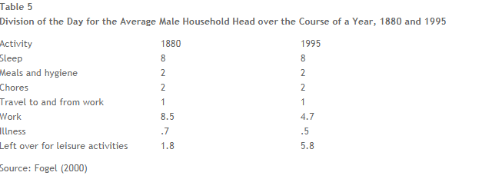
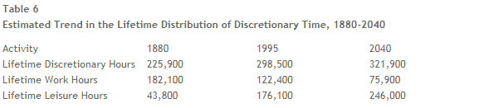
Why are we so crazy
Is it our workload or our expectations?

Slide 6
First Things First
NOT about doing more stuff
IS about a meaningful life
Seek Significance in what you do

Slide 7
Time Management Theory
Efficiency – do it in less time
Prioritization – importance vs urgency
  Urgent – how soon does task matter
  Important – how much does task matter
Significance – is this a difference maker
  How long will the effects of this task last

Slide 8
Efficiency
Stay in the moment
52 on, 17 off
Touch each thing (e-mail, inbox item) once
Dictate everything
Participate in System improvements

Slide 9
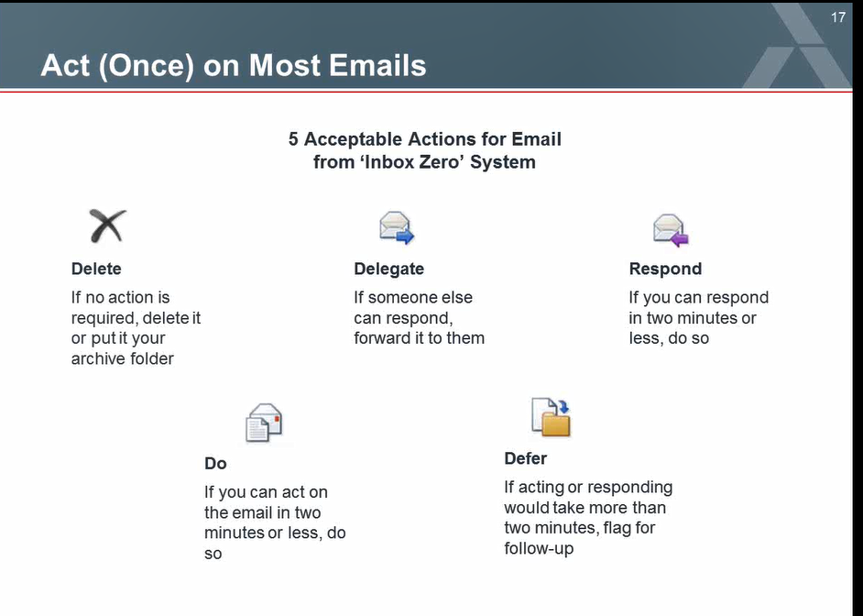

Slide 10
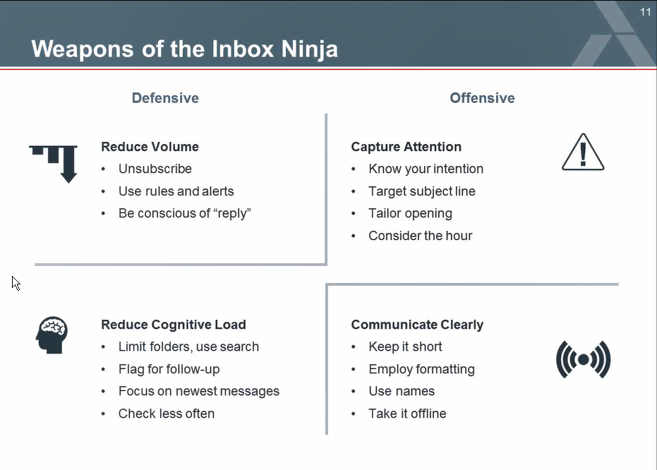

Email and Inbox efficiencies

Slide 11
Prioritization
High Priority Quick Fix | High Priority Difficult to complete
Low Priority Quick Fix | Low Priority Difficult to complete
Importance
Urgency

Slide 12
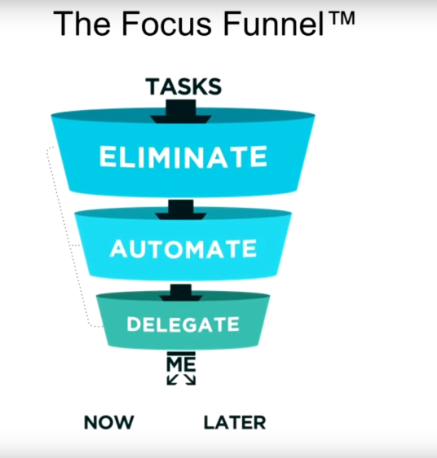
Choosing where to spend your time
Notes:
Role play how to say “No”

Slide 13
“To Do” Do’s and Don’ts
DO
  Structure your to do list according to your priorities
  Use religiously
  Look short term and long term
  List individual tasks to meet larger goals
Don’t
  Take longer on your list then you do on your “To Do’s”
  List what you have already done so you can check it off

Slide 14
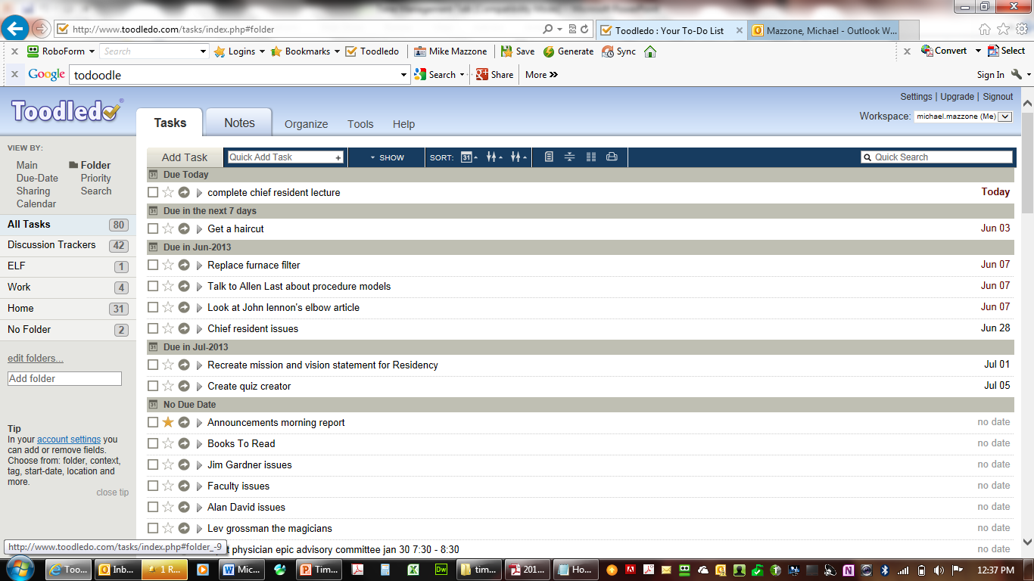

Slide 15
Things that apps can do
Synchronize multiple lists
Reorder tasks
Quick capture – voice activated/ fill in features
Group and ungroup
Make sub-tasks
Mark importance
Mark urgency
Available on multiple platforms
Alexa enabled

Slide 16
To do List websites and apps
ToDoist
Wunderlist
Microsoft To-do
Toodledoo
Any.do
Remember the Milk
Evernote
google tasks
HabitRPG

Slide 17
“We’ll train the Humanity right out of you”
1) Take frequent breaks
2) Carve out a chunk of time each day--at least 15 minutes -- that is strictly your own.
3) Create "snow days" once in a while.
4) Stop focusing on just the "big stuff"
5) Make time for what it is you like to do.
6) Don't sacrifice vacations
Source: New Age Journal, May 1996

Slide 18

NEVER UNDERESTIMATE THE IMPORTANCE OF PLAY AT WORK

Slide 19
Never be JUST a doctor
I’ve never heard anybody say at the end of their life, “You know, I wish I worked harder”

Slide 20
Excellent Texts
The 7 Habits of Highly Effective People : Powerful Lessons in Personal Change
by Stephen R. Covey
The Fifth Discipline : The Art and Practice of the Learning Organization
by Peter M. Senge
The 10 Natural Laws of Successful Time and Life Management : Proven Strategies for Increased Productivity and Inner Peace
by Hyrum W. Smith
How to Get Control of Your Time and Your Life by Alan Lakein
101 Ways to Make Every Second Count : Time Management Tips and Techniques for More Success With Less Stress
by Robert W. Bly
Fish! Tales by Stephen C. Lundin

Slide 21
Internet References
Mindtools: How to Manage Time
  www.mindtools.com
Links to Time Management Resources
  http://www.uni.edu/walsh/linda7.html
Interlearning - time management web based course
  http://www.interlearning.com/prodtimemgt.htm

